Slide 1
Keys to the Kingdom: Becoming a Network Architect
Mike Courtney, Director of System Engineering at Ramen
LinkedIn: https://www.linkedin.com/in/boston1630/
BlueSky: @mikec11.bsky.social
Notes:
This should be relevant to everyone in the room.
No matter who you are, if you're related to networking, this is what you will get out of this talk.
Engineering -> Looking to make the step into an Architect
Architect -> mentor our field, grow and get even stronger
Mentor - what would you want to tell them consider it a path. Relevance whether an architect.
You will have something to take away from this talk.

Slide 2

The Journey
Two Parallel Tracks
Technical
Professional
Notes:
IMAGE URL: https://geekgirlpenpals.com/wp-content/uploads/2014/11/Sam-and-Frodo-walking-through-the-Shire-e1442939038426.png
This talk came out of a discussion I had a with a good friend. This good friend is just getting started in the networking industry. We were shooting the breeze and he was asking me about subnets, VLANs, routing, stuff like that. I had told him, “Sounds like you’re gearing up to be a Network Engineer.” He replied, is that what you do? I said no, that I was a network architect and he asked me, “well, what the heck is that?”
Asked me this back in October and I have not been able to get this question out of my head. This whole project that I’m about to describe really came out of dog with boning this question for the past couple of months.
I don’t know if this is in the zeitgeist, but Jason Gintert, one of the founders of the USNUA also wrote something in the past month on this topic.
There is no one thing, there are a set of technical and professional skills that help you take it to that next level. That’s what will be talking about today.
This is one person’s take. Someone who has been on this journey and back again.
(You see what I did there?)

Slide 3
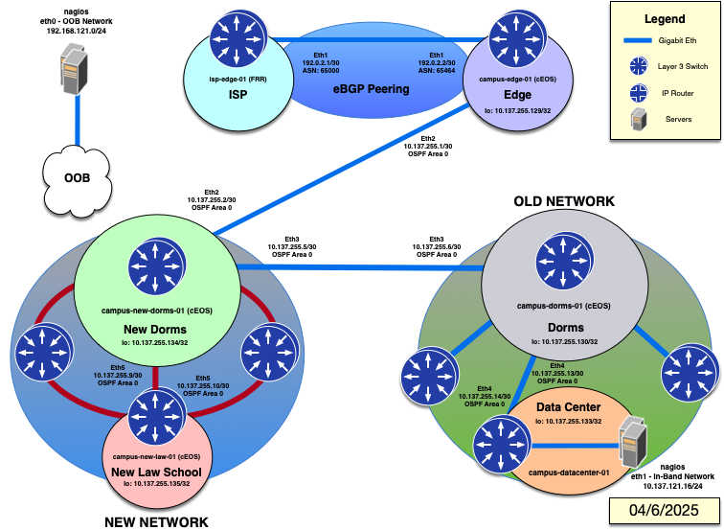

Technical
A lot of ground to cover.
What’s included:
Lab 1 – Hub and Spoke Topology
Lab 2 – Enabling Dynamic Routing
Lab 3 – Enabling BGP at the edge
Lab 4 – Migrating Networks
* Lab 5 - Ring Topology (4/11)
* Lab 6 – A/A Data Center w/ MPLS
* Lab 7 – A/A Data Center w/ EVPN
Notes:
So let's talk about one branch of the path
I reached out to another friend as I was getting my mind around this topic, Pete Lumbis. He is someone who often appears on Packet Pushers, Cables2Cloud, The Cloud Gambit, The Art of Networking Podcast, etc., I wanted to aim to do with this project – how I wanted to have a discussion about the professional skills, the business acumen, as well as the tech, and he said something like, “how many days long is this presentation?” Which is a fair point.
This is what I was going to talk to about initially. I do want my friend to understand how the tools that he is learning can be combined together on the technical side to do something that is truly creative.
I was going to talk about the technical aspects and the interpersonal and business skills that are more softer skills of being an Architect.
The above is something that I have done in parallel. So there is a QR code which will also be present at the end if you’d like to step through this design of an L2 design
I am uploading Lab 4 tomorrow, and will upload the three over the next next couple of weeks. Labs 1-3 are now live.
So I’ve decided to break this into two, parallel parts. First, there is this talk, which will focus heavily on what I had to do with the other engineers, peers, and companies, on my first network architecture project.

Slide 4
Table of Contents
Business Goals (Setup)
Decision Makers / The Players
The Technical Sale to Leadership
Rally the Team (Buy-In)
Troubleshooting + Triage
Coworkers (Permanent / Temporary)
Support the Team
Wins and Fails
Managing a Project (Execution)
Waterfall + Agile Methodologies
Wins and Fails
Notes:
I've broken this talk up into 3 sections
These are the three big areas that I would like to cover as one goes from a Network Engineer into a Network Architect.
Managing up
But let's talk about these professional skills that are necessary to become a Network Architect.
Second is the Rally the Team, here is where you are working with Network Engineers, Network Administrators, and
Managing personnel or managing horizontally
The third section is managing the project in general. This is where you learn to make the vision a reality through various project management methodologies.

Slide 5
A Network Engineer*
A Network Architect
Certificate Driven
Console jockey
Ton of L2 + L3 experience
Limited managerial experience
Years of Experience
Works with leadership
Automation + Delegation
A Project Manager
Notes:
Let’s talk about this theoretical engineer and what he had to learn. The reason I’m laying this out so that I can baseline where I believe a network engineer starts and where they can go using the subjects in this talk:
Question: What are the qualities of a network engineer / or someone getting into this industry from a technical perspective?
You don’t just jump into a Network Architect position, this often takes 3+ years to feel comfortable before making this jump.
* And this idea of a Network Engineer could also be a Consultant, or a Staff Augmentation Engineer working with an organization.
== EXTRA ==
There is also the part of this talk where I’m having a dialogue with my younger self. I can tell there are a couple of people in this room who have been around a couple of days, and sometimes if you’ve been doing this for a while, you often talk as a senior person to a senior person, especially if you’re in the startup game, like I am.

Slide 6


Business Goals
Notes:
This is the area where you will be managing the project upwards with leadership

Slide 7

Notes:
IMAGE URL: https://insuranceproshop.com/best-solution-for-your-clients/
The BEST solution might not be the solution that the business chooses.
Let me repeat that: The BEST solution may not the best solution that the business chooses
This was a very hard thing for me to understand when I was younger.
The people who give the thumbs up on a presentation may not be interested in the best technical solution, they have their own goals and agendas that may cause friction between your engineering goals.

Slide 8
Decision Makers
(The C-Suite Discussion)
Notes:
Q: What do you guys know about the C-Suite? Who do you know in the C-Suite?
You may hear the term “C-Suite.” For people new to this, this is often the “Chief”s in an organization.
CEO – Chief Executive Officer – manages and shape the overall organization. They are often the go-between the board of directors, usually they’re the chairman of the board, and organization. The “President” of a company usually shares roles with the CEO, but is often the second in command.
CTO / CIO + CFO / CRO
COO – Chief Operating Officer – directional, HR,product, manufacturing,
CMO – Chief Marketing Officer – in-charge of all outward facing correspondence
CISO – Chief Information Security Officer
New ones like CPO / Chief People Officer, CDO / Chief Digital Officer
Often times, these people report directly to a board. They also have a fiduciary responsibility to the shareholders or stakeholders in an organization.
They also usually get paid the most
It’s also worth noting what the average tenure of these positions is:
CTO – Tenure, 3-5 years
CFO – Tenure, 4-6 years
Why is that important? Because, their agenda may not be your agenda. You can help them achieve their goals to help you achieve your goals.
Now, if you think that’s too Machiavellian, you’re right – it definitely requires emotional intelligence and conversational skills.

Slide 9

The Players
CTO / CIO / CISO
Chief Technology Officer / Chief Information Officer / Chief Information Security Officer
Controls the direction of IT
Notes:
IMAGE URL: https://www.ncesc.com/wp-content/uploads/2021/07/cto-job-description.jpg
Question: we talked about X,Y, does anyone know what Z means?
When you’re in a network architect leadership role, you may report directly to the Director of IT or to the CTO themselves.
The CTO is the technical leader of the entire organization. They may have directors underneath them. (The CISO might be under them).
Dotted line vs a straight line
CISO may act as an overlay for the entire organization, rather than being silo'd off. Standards, logs, security elements
It’s important here to understand what is their agenda for the organization? If for instance, they have a goal to have a large percentage of the organization moved to the cloud, tailor your goals based on that. If they have a SaaS agenda, or a security agenda, knowing this ahead of time can help you speak the language that they understand.
CTO – Tenure, 3-5 years

Slide 10
Martin Casado – CTO can mean:
Engineering Leader
Chief Scientist
Super SE
Academic
Architect
Notes:
IMAGE URL: https://x.com/martin_casado/status/1120413624001028097
Let’s talk a little but more about that language.
Question: Has anyone heard of Martin Casado? Do you know what business he built?
A: Martin was the founder of Nicira, which was later sold to VMWare as NSX, and is a partner at Andreesen Horowitz.
He was legitimately one of the founders of the software-defined networking movement from the last decade and someone I've heard speak. He tweeted the above and it honestly lives rent free in my head.
I have literally worked with CTOs from one end of this. People who are completely task masters, people who were one system engineers, maybe a “Field CTO”, all the way to people who could quote academic books from Stanford.
Jeff Geerling in STL, Dr. Matsakis from NIST who became Chief Scientist for MasterClock in STL
URL: https://www.youtube.com/watch?v=zT71UvUxhjU&t=1s
You could have someone who teaches part-time at a university or is plugged into an alumni group where they are active.
Understanding this has been very helpful to understand how to work with someone in this position.
You can help understand how to position your solution by understanding where they are on the above.
For instance, if they’re more of an academic type, have them join in the discussions with the vendors you’re evaluating. See if the manufacturer CTO or CEO would talk with your CTO. Also, when working with a VAR, see if there are regional events where the CTO can take pride and present on what you’re accomplishing together.
For someone who is an engineering leader CTO, ask if you can join them in a meeting with their direct reports to discuss the solution and gather feedback from other organizational leaders.
Chief Scientist, create a dialogue with them and people at a manufacturer that have written patents for their product. You may also use a site like LinkedIn to help create connections between a solution and your CTO
Or, just straight vanity play and on how this organization will be now and ahead of similar organizations. You will oversee the construction of one of the most impressive networks in our peer group, bar none. When they next meet with their peers, they will be able to brag about what they’ve accomplished.

Slide 11

The Players
CFO / CRO
Chief Financial Officer / Chief Revenue Officer
Controls the purse strings
Notes:
IMAGE URL: https://www.driveninsights.com/hs-fs/hubfs/what%20is%20a%20cfo%20service.jpg?width=5616&name=what%20is%20a%20cfo%20service.jpg
Question: Do you know what CFO / CRO stands for?
They have the responsibility to report to the CEO and to the board of directors on the state of the business and the overall cash flow, spend, and all financial decisions.
This person is used to people giving polished, solid presentations. This may mean that you will need to level up your speaking skills before talking to a CFO. I have always been with a CTO / CIO when I was presenting to a CFO.
CFO – Tenure, 4-6 years

Slide 12

Financial Considerations
CapEx
Capital Expenditures
Refresh every X years
Paid for up-front
OpEx
Operating Expenditures
Refreshes built in
Paid yearly, fixed (ish) cost
Notes:
As a Network Architect, you will directly with VARs and resellers to come up with the solution that works best for your organization. It’s important to go into those meetings knowing ahead of time the financing model that works best for your organization.
Questions: Heard of CapEx? Heard of OpEx? What is that?
When you’re working on a project, it’s not going to be free
For instance, say you’re working with Cisco, Juniper, Arista, Aruba, Nokia, etc – they will give you an idea for the cost of the overall project. Let’s just say it’s 5 million dollars
OpEx is almost like leasing. ‘ish = Co-term new expenditures
They might not have visibility into what happened in the past. Or, they may say, in the past we rebuilt this network and had a bucket of money that was 4 million. We can do that again, but you need to shave off

Slide 13
The Technical Sale to Leadership
CFO:
Know the financials, in and out
What is the risk of not doing a project like this?
CTO:
Scalability, reliability, security
How this meets their roadmap and goals
Organization can grow with this design
Notes:
With the CFO, you want to provide the language that they speak. You also want to avoid “going back to the well.” If you have the design, you know the budget, you should be able to provide the total cost of the solution in a CapEx and an OpEx model from the manufacturer and VAR.
Two examples for the CFO:
CFO – I worked for a company where the topology was a hub and spoke with a spanned VLAN. The network would have to - and this is no kidding - you’d have to pull the power on the main switch and then it would come back up. The risk was, we have no visibility into this network, what would happen if this occurs during finals or during commencement when it is broadcast to the entire alumni community?
CFO – Race to the finish line at the end of the quarter to make sure that we were able to use the available funds that were just weeks from going away. The risk here was that those funds were not earmarked for the next year.
CFO: Can they make money from your proposal?
Can this benefit the organization in anyway that they can present to the CEO and to the board?
CTO – Wanted to understand how they could get their ratings up on yearly employee reports. That networking was generally ”slow” and how this solution could help them overcome this and improve their rating with staff.
CTO – They had an open office plan, come hell and high water and that is what they were going to make work
CTO – You’ll get a call with a known billionaire if this plan isn’t tripled vetted by the vendor.
CTO – I want to put together the most bleeding edge and I want to see it work.
Negotiating your best solution with the solution that they are looking for
Let’s talk about an example of where this came into play
CTO:
What are their business goals? Do not assume your goals and those goals align? Can you find a way to bridge the gap between.

Slide 14
Rally the Team
Notes:
What have we talked about so far, we have talked about what it is like to manage up. To work with the leadership team to make the solution a reality.
Now, we are going to switch gears and talk about managing the team that will help roll out the deployment.
Other peers, Administrators

Slide 15
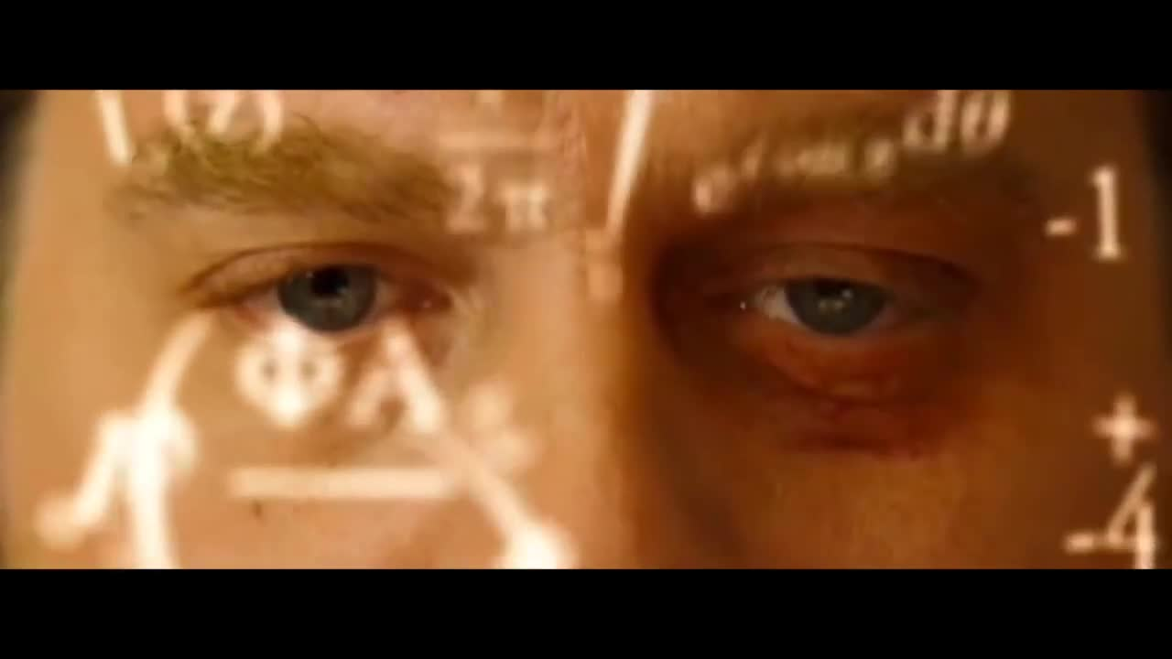
Network Omniscience
Notes:
Image URL: https://media.vlipsy.com/vlips/unXhJxNK/preview.jpg
From “The Hangover”
A huge area of Growth.
Question for you: who here can look at a network and just understand where there could be an issue?
Like this picture above when Alan in the Hangover goes down and he starts counting cards.
I used to be very much like that, when I would start off a project, I would come in and just more or less understand what they were looking for and where they should have gone. I didn’t ask questions, I didn’t think I needed to.

Slide 16
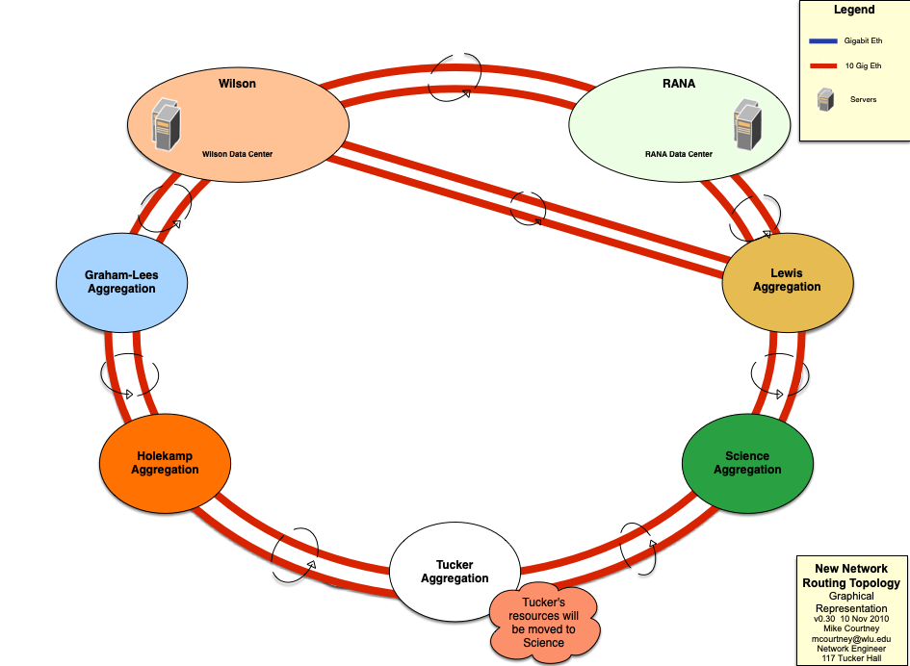
Notes:
This is a design where I took a campus LAN network and changed it into an ISP-level design with active / active data centers using JUNOS and MPLS.
It was a super elegant solution. It's still in place 13 years later, just with newer hardware moved from MPLS to EVPN.
You’re operating a high level, how do you talk with the rest of the team / how do you show the value of your design and get people to believe in what you are doing?
How do you explain this to someone and make them feel comfortable with this?

Slide 17
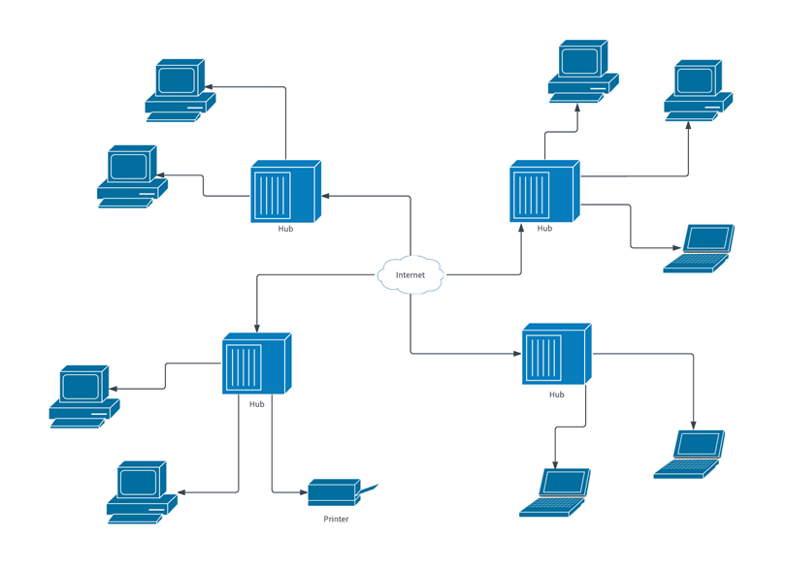
Notes:
Especially if the people you are working with may have a design similar to this. Where you are providing an "elegant" solution that might as well be in a different language.
Or, you may be working with people who's whole understanding of networking may be
http://www.obfuscata.com/wp-content/uploads/2017/12/network-diagram-3.png

Slide 18
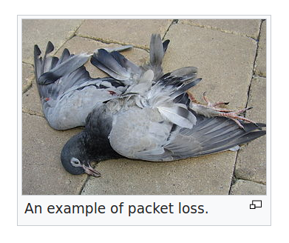
Notes:
RFC 1149 - IP over Avian Carriers
https://www.rfc-editor.org/rfc/rfc1149
==
We work on a network where the magic happens everyday and we honestly have no idea how it works

Slide 19

Notes:
IMAGE URL: https://beckett-www.s3.amazonaws.com/news/news-content/uploads/2022/10/2022-Topps-x-MLB-6a-Bobby-Bubbles.jpg
As we transition into this next section. One thing that I was definitely not good at, was giving deference to the people who had previously built this network.
My boss at the time had an amazing career in telephony and overall wiring design. He basically inherited networking and did not have any of my fancy routing or certificate experience.
And here I was throwing together a new design and saying in not so many words that their "Baby is ugly"
and my attitude gave off that approach

Slide 20
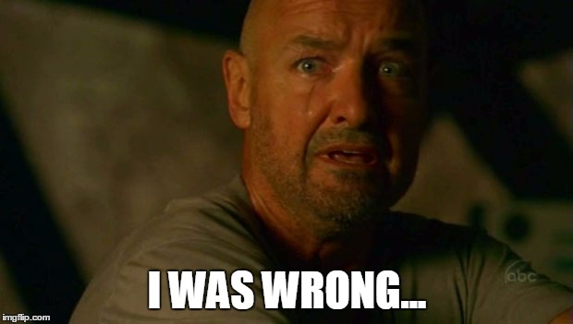
Notes:
IMAGE URL: https://i.imgflip.com/121rlm.jpg
I needed to listen to them, I need to understand what they had build, I needed to have the humility to understand where they were coming from, what they were trying to do, and what we could do as team going forward together.

Slide 21
Meet Coworkers Where They Are
This was the hardest lesson for me to learn when I was younger
Coworkers - not in-the-weeds networking people
I had to meet them where they were
My humor / social skills were not enough
Notes:
Image: Meeting people where they are.
Question: Before I move on, does this resonate with anyone in the audience?
I was in the middle of getting multiple expert certs, I was lab’ing every night, it was all enveloping
For me, and maybe for a lot of people in here, too - this was not a 9 to 5, this was a way of life.
This was not just my job, it was my identity
AND
There are people who it is a 9 to 5. I had to understand what they needed to be successful, to help empathize where they currently were and to help them bridge the gap to understanding what I was trying to do
Emotional intelligence will not be enough here, they will need practical support
Me, coming in, bulldozing what they've been doing and then being funny probably came off like a pretentious asshole - pardon my language.

Slide 22
Support the Team
Training
Travel
Trust
Notes:
Question: For the audience are there other things that you would recommend to network architects to help support their teams?
This can lead to an incredible opportunity for you and those members around you.
For those who have more of a passing interest in IT, there has been a 5-15% cut on average from formal training. As part of a large-scale project, you can up-skill the members of your team and factor that into the budget of this project Example: Executive Briefing Centers - Lot in Silicon Valley and outside of Ashburn, VA on the east coast, VARs like training centers. At Nvidia we worked with a VAR in St Louis who had their own training center.
To go along with the above, and with what I’m recommending with the CTO, you should get some regional or national passes to vendor events as part of this purchase. Make sure you shower these perks on the people who are going to be doing the work. Showing this type of love will go along way. Try to get one outside of the area where you reside. For instance, if there was a regional event in KC, that might be nice, but one to StL, OKC, Omaha, Chicago, Minneapolis, might be more of an attractive even to people you work with.
Trust –Trust in the solution that you are looking to deploy. What does the team need to feel confident? Include key members of the team in meetings with the manufacturer and the VAR. Make sure to explicitly ask the team before a meeting to have a question ready – that every question is worthwhile. Engage those members of your team in this dialog. VARs loving taking people to lunch – make them bring out the credit card for your team. Get them to also feel familiar with the upstream support of the VAR and manufacturer so they realize that everyone is in it together.

Slide 23
Wins and Fails
Command and Control – ISP in Western KS
Working alongside their Director of IT
Legacy Network Trying to implement DSCP / QoS
Frustration on both sides
Show and Tell – FinServ Company in Illinois
Had used same vendor for almost 10 years
Nervous about change
Training / Meetings, rinse and repeat
Notes:
The first is an example where I was trying to control the deployment and did not meet the people where they were.
This was part of a large educational rollout where we were interconnecting BGP peers to ISPs across Kansas. For many of these organizations, they had never run BGP.
On top of that, we were looking to prioritize QoS across their network and across our network for voice and video calls by making sure that DSCP markings were honored across system boundaries.
Now, if what I just said is a second language, that is what the person was hearing on the other end of the phone. I did not rally them and their troops and needless to say, this led to a lot of frustration on both sides.
Here’s a different example with a FinServ / Financial Services Company up in Chicago.
As I became engaged with them, they had been using the same vendor for almost 10 years. They had multiple rounds of staff, and multiple rounds of leadership, and they did not have any muscle memory of transitioning to a different vendor.
The main feeling that they said was around fear. Fear of making the wrong choice, fear of doing something different, fear of doing something out of their comfort zone.
So based on the previous slide, how did I handle this. One, We had free on-site and remote trainings with their staff. They we ran through multiple PoCs to address how they were doing business now, and how they could do business in the future. We did an on-site training with one of our main resources, and we invited the CTO to our on-site EBC in California. And, over time, this helped to reduce the anxiety that they felt.
Where they had fear, they gradually found comfort.

Slide 24
Managing Projects
Notes:
At this point, you’ve gotten buy in by the decision makers, you have rallied the team to do the work and sold them on the vision. You have future resources and training lined up, you’ve helped to ease the anxiety and helped them feel confident
The next step is to execute the plan.
In order to do that, you’ll have to become knowledgeable about the methods and frameworks of managing a project.
Question: What are the top 3 project management frameworks?
Waterfall, Agile, and Scrum. Are there any Scrum people in the room? If you’re interested in Scrum, you can go to scrum.org. (SIERRA CHARLIE ROMEO UNIFORM MIKE)
I have found that larger organizations have their own project management teams that run the execution but often require input from network architects on the implementations.
For smaller projects, it often falls on the Network Architect to have the experience to use a project management framework to come up with a design in tools like Asana, Jira, Microsoft Project, OmniPlan, Notion, etc – there are a lot of options. It’s important to become familiar with the tools that a larger organization uses or ones that you feel comfortable with on individual projects. I’m an OmniPlan guy.

Slide 25
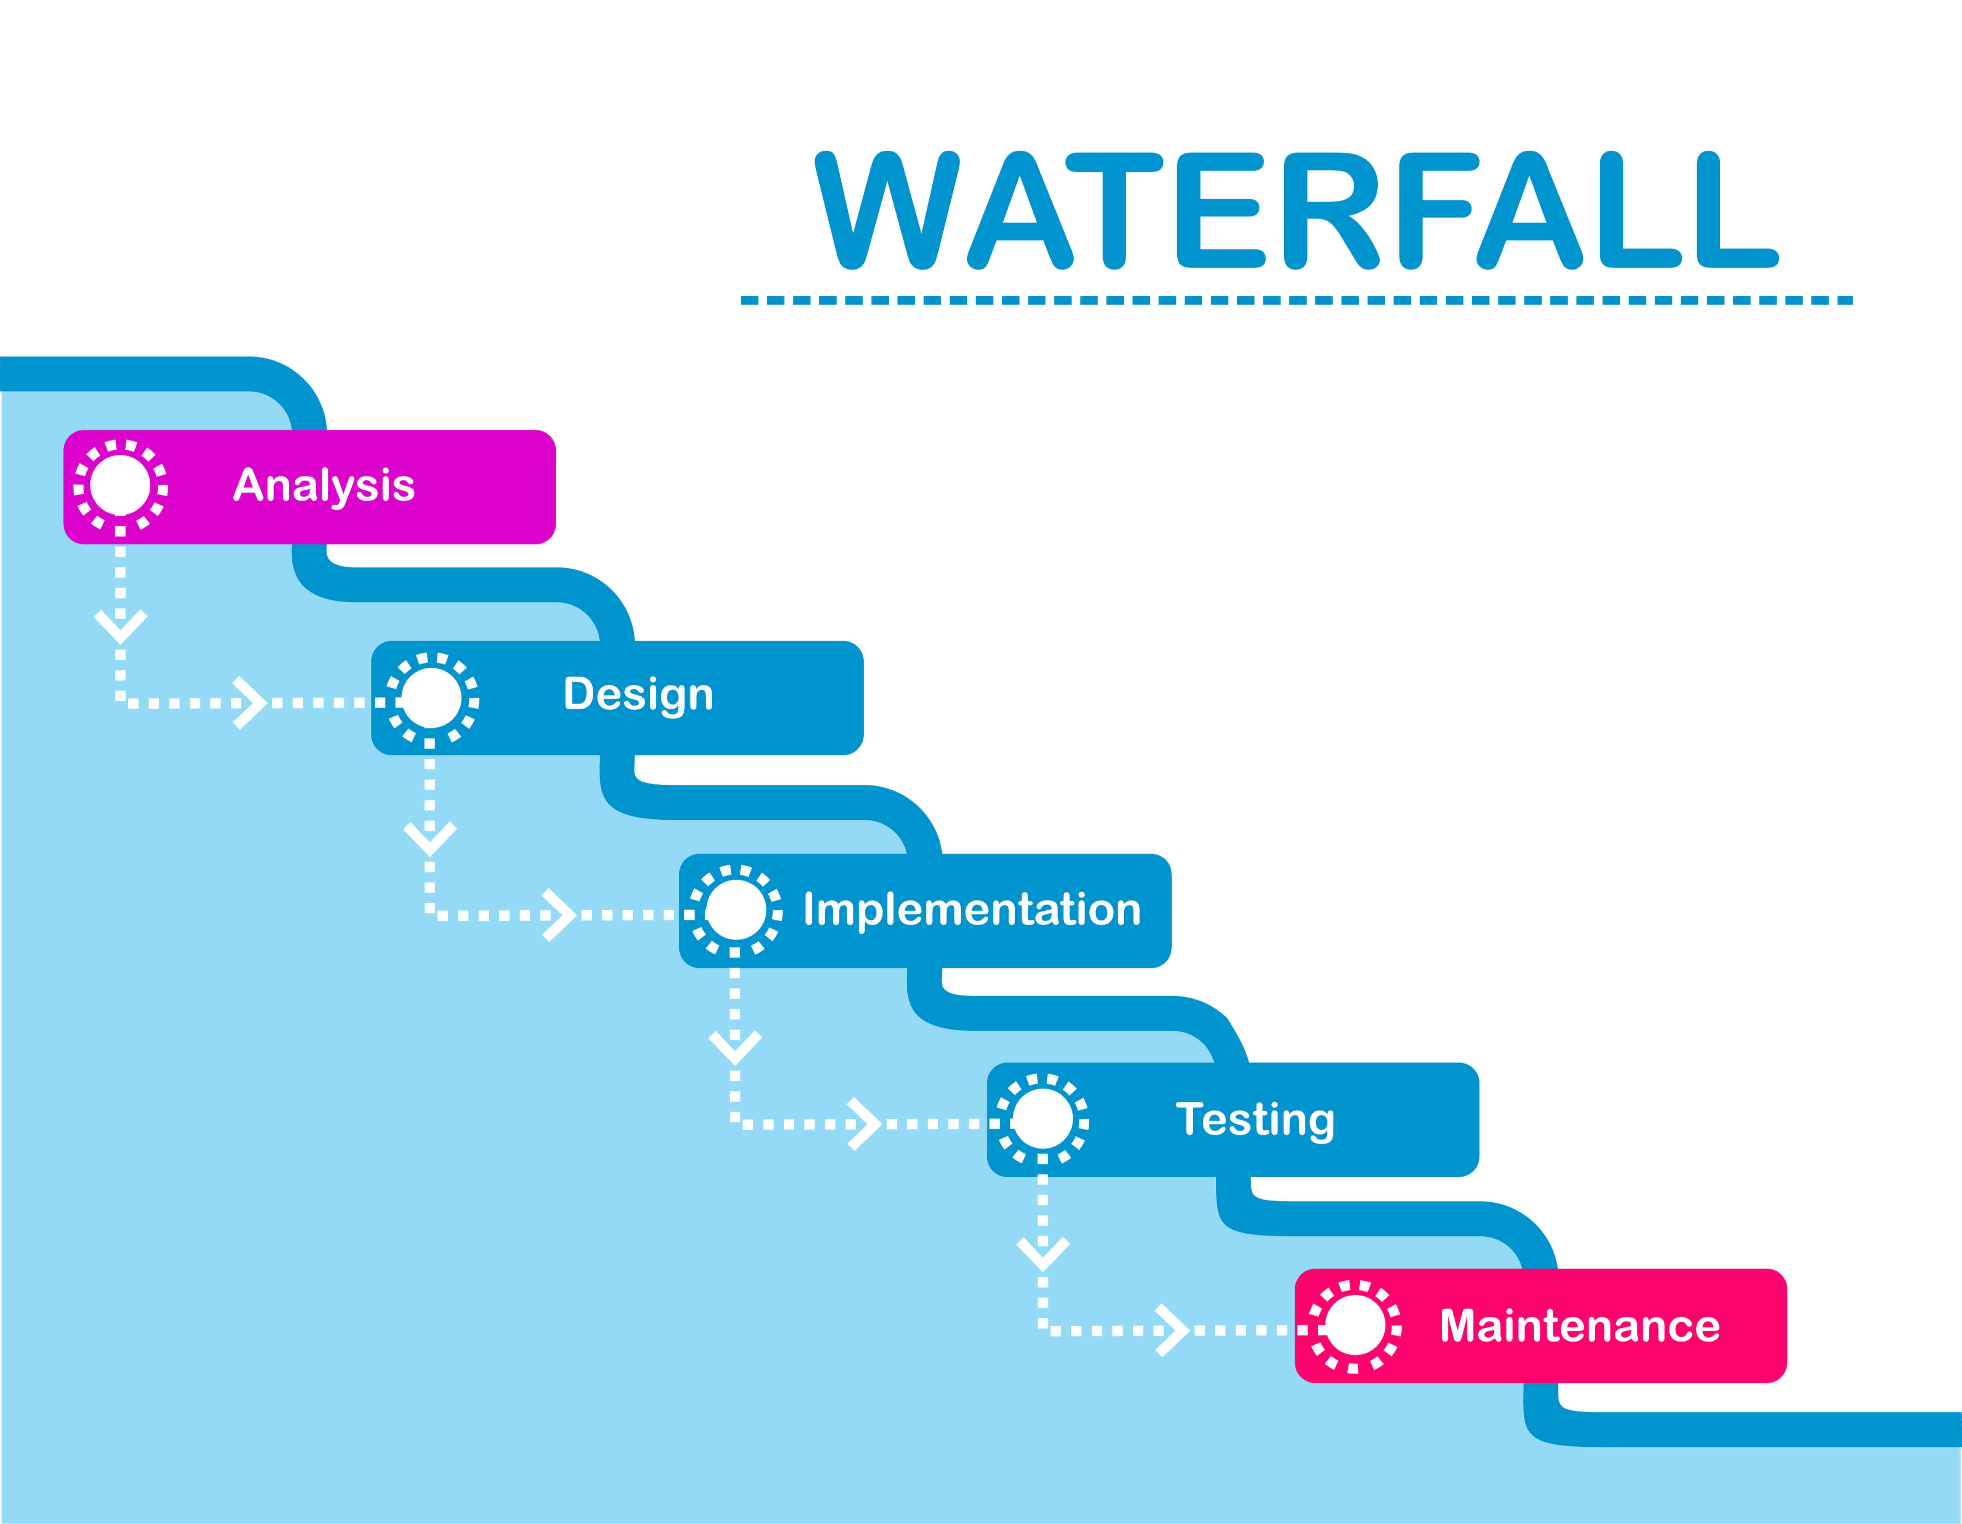
Notes:
This is the most popular form, in my opinion. This is where one item leads to the next
Extensive planning from the get go. Front-loaded experience
You can do things like outline all of the steps, get all of the feedback, costs, inventory, set timelines and milestones all at the front before the work starts. It avoids the changing the engine while you’re driving type issue.
Defined milestones, defined goals. Easily repeatable for similar projects
Not a lot of flexibility in this design. If you’re down here, and something changes up here, it’s harder in this framework to go back to the beginning and adjust.
Before we go to the next slide, there's a popular type of "chart" used in Project Management, anyone have a guess?

Slide 26
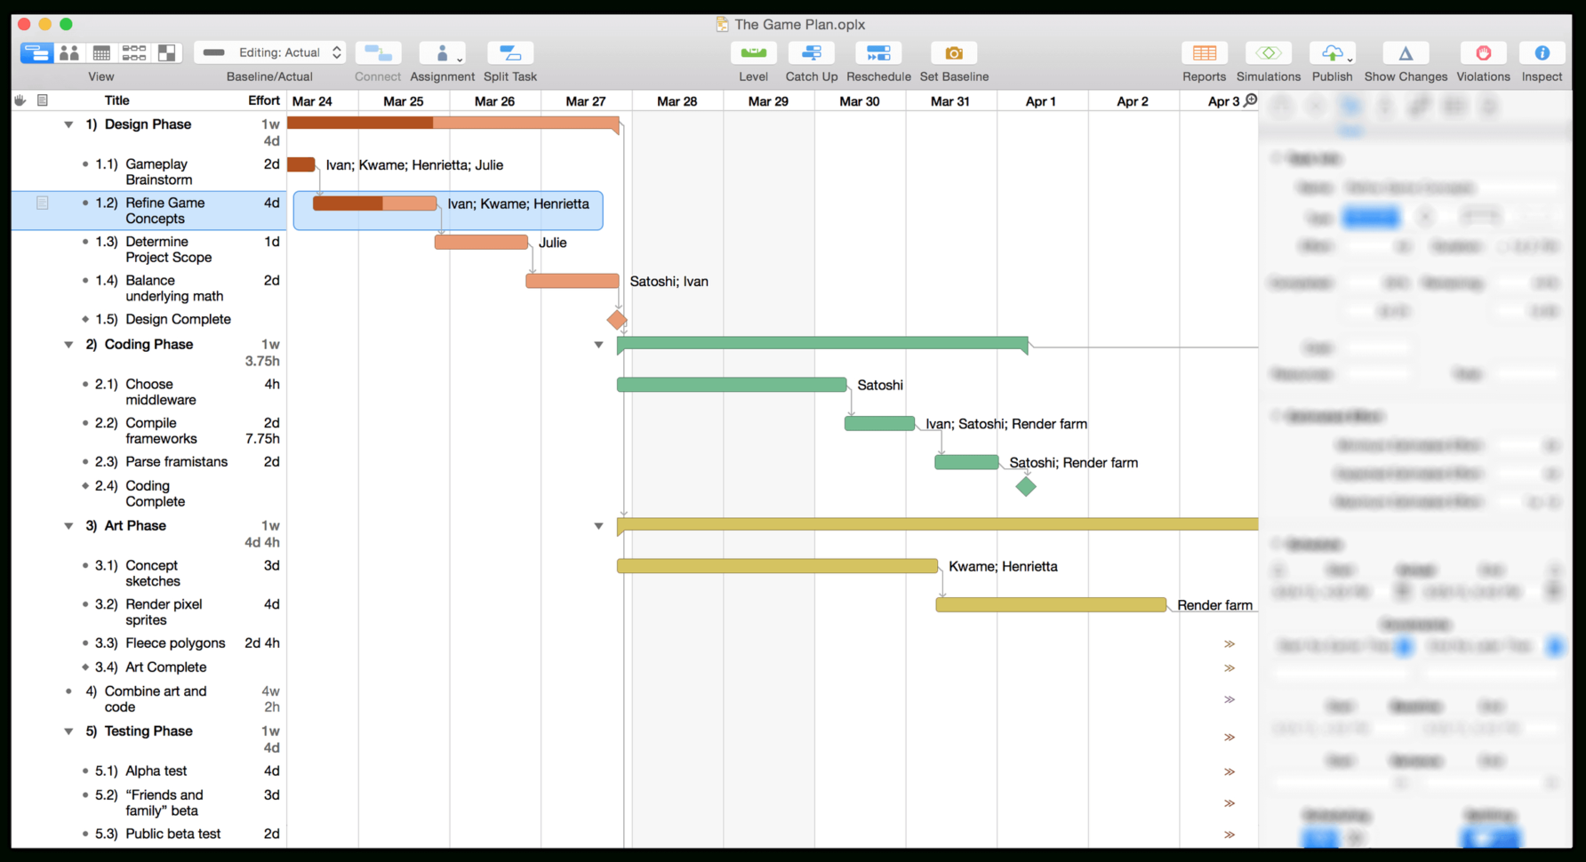
Notes:
IMAGE URL: https://db-excel.com/wp-content/uploads/2018/10/omniplan-3-for-mac-user-manual-getting-to-know-omniplan-within-gantt-chart-template-mac-1784x970.png
Having a framework and a Gantt Chart has been around since World War 1 - https://en.wikipedia.org/wiki/Gantt_chart
People, time, resources
You can put expectations into the design. Over time, you'll usually have tighter expectations when you start, and you'll learn to put more slack into a project as you go.

Slide 27
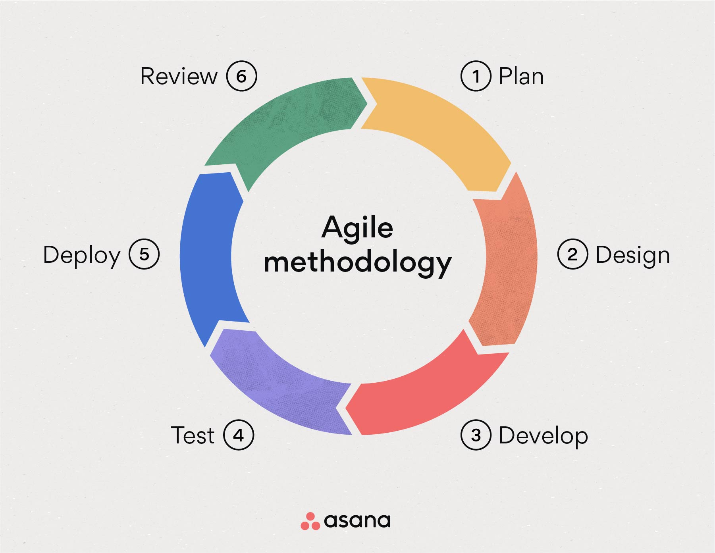
Notes:
Question: Do you the name for the pieces of an agile project?
Answer: "A sprint"
A sprint is usually a couple weeks, no more than a month long.
You may have heard this if you work in an organization that does software development, where it is very popular. I did this as part of software development group at Nvidia and it was eye opening to see it done correctly.
The goal of this is to break up the whole project and work collaboratively to and rather than go from one piece to next, to work on a
May have a higher-level design from the get go, but can be adapted on the fly as the project progresses.
The end of of a sprint will have a deliverable as testing is a phase of these projects.
Think about how that is different from waterfall. You may not start the testing until the very end, rather than testing and iterating throughout the project.

Slide 28
Wins and Fails
Short != Easy – Health Organization in Washington, DC
Did not have a waterfall plan, only a SoW / Statement of Work
Head down, focused on the end, not the result
Did not “Rally the Team” - the team was not able to catch up
Combo Approach – University in Indiana
Diagrams + Project Plans for 5 step AI network inclusion
Combination of Waterfall + Agile methodologies
Experience, and the confidence to say…
Notes:
A lot of this comes with time and experience. Also, having kids and setting guard rails helps, too. Kids, the best management training.
Short does not easy
Combining the technical with the professional skills.
Cadence for this was Milestone -> meeting, milestone -> meeting.
If you really want to blow someone's mind, use the milestones and the tasks in daily / multiple times a week status updates. Update the Gantt chart in real time. This allows you to work with leadership to say, we have accomplished x, y, and z, I will need x people from your team to help get to the next level. $person1 + $person2 are doing great and to go over the success of the project as you
Highlight the project and success to make sure that everyone is on the same page and to give kudos up and down.

Slide 29

Saying “No!”
Notes:
IMAGE URL: https://i.imgflip.com/782uav.png
Saying no to avoid “scope creep.”
Question: has anyone heard that term before and could describe it?
This is a term for things that are added outside the bounds of the project, as it is currently design. With time and experience you’ll be able to say, “that sounds really important to you. This will be addressed in the next project following this one?
”Would you like us to delay this project?” OR “What would you like me to remove from our current project to make room for this?”

Slide 30
WHO IS A NETWORK ARCHITECT?
1. They can negotiate with leadership
2. An Architect builds up their teammates
3. You will become a Project Manager
Notes:
PMP – Project Management Professional=
https://www.pmi.org/certifications/project-management-pmp
Full circle, I said at the beginning that a Network Engineer could be: Certificate Driven, Console jockey, Ton of OSPF + BGP experience, Limited managerial experience
They will feel comfortable with leaders in the C-Suite and articulating their ideas
They will listen to the people who you will lead and meet them where they are
Understand the methods and frameworks as you low key become a project manager.

Slide 31

Bonus:
Grow within this community!
#SILICONPRAIRIE
Notes:
IMAGE URL: https://www.worldatlas.com/r/w1200/upload/b7/0a/a2/shutterstock-344201303.jpg
My high school gym teacher used to say, “the bonus light is now flickering!” as he’d double the points. So this is an extra set of slides I wanted to throw in there, as I believe it is super important to someone getting into this career.
In the past, events like this would be vendor or VAR sponsored. This is what happened when I lived in Virginia. For them, it was a great way to bring people together
I know that in the KC area there were some starts and stops for networking automation before pandemic.
I knew of what Jason and Chris were doing with the nascent USNUA group in Ohio almost 10 years ago.
This is a non-partisan group where you. I was very proud to attend the first event in Kansas in Wichita a year and change ago, and very happy that we are now having our own events here in KC

Slide 32
Slack Communities
USNUA - https://www.usnua.com
Packet Pushers - https://packetpushers.net
Notes:
Especially the Slack Groups for the Packet Pushers and the USNUA
A couple of other Slack groups: Wi-Fi Pros, NetDev Community, Free Range Routing, Cloud Networking as Code, Network Automation Forms
Vendor specific groups, too, and I’ve seen people setup Discord servers, as well.

Slide 33
Thank you!
Mike Courtney, Director at Ramen
LinkedIn: https://www.linkedin.com/in/boston1630/
BlueSky: @mikec11.bsky.social
GitHub: chronot1995
Notes:
And includes me in that community, as well. I'd be happy to help you, love to answer any questions that you may have about your career, technology, or networking in general. Reach out to me on any of the above and we can grab a coffee in the city.
I’ve been using BlueSky a lot more recently. It feels like Twitter back in 2014 / 2015. Follow me on there to get some cutting-edge analysis of John Cena’s heel turn with the Rock and what that means for Cody Rhodes.
Thank you!
Any questions?

Slide 34
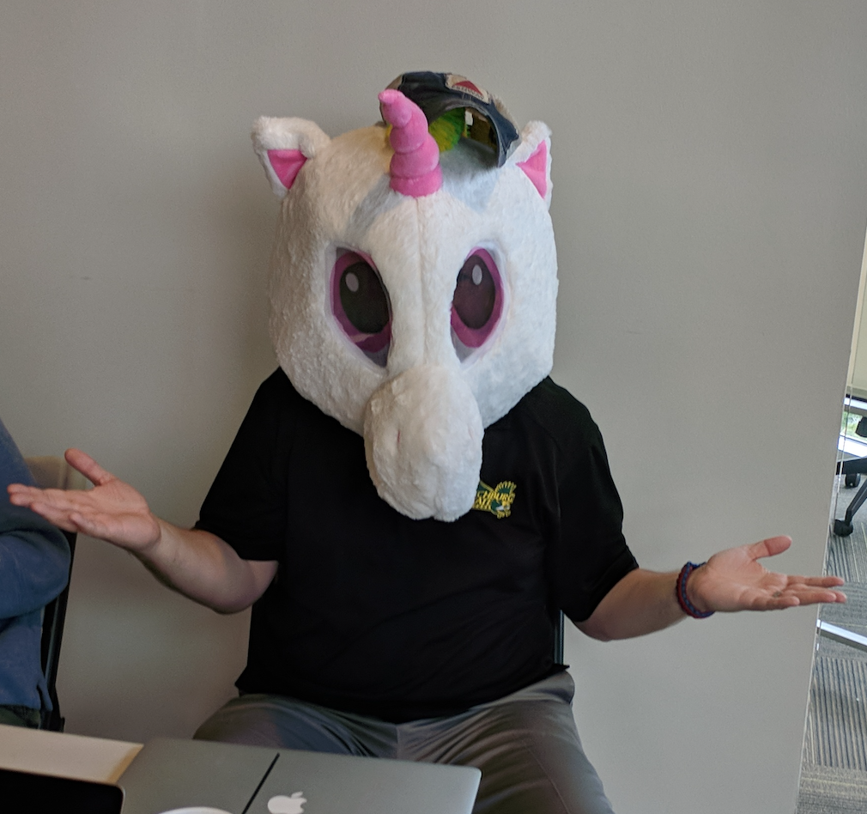
The Network Architect
Aged like a war-time president
200+ customers
$ number of platforms
Automation
Notes:
He didn’t realize that he would eventually work with over 200 customers and that having two kids during the pandemic wasn’t a “flex”

Slide 35

Addendum
Notes:
IMAGE: https://www.ccstechnologygroup.com/wp-content/uploads/2019/08/key-firewall-features.jpg
The actual biggest change I made in that first Network Architect engagement is not what you think.
I changed two lines of code.
It goes to one of the other key aspects when you’re a level above an engineer, and that is listening.
Let me discuss. After 6-9 months, I was in a meeting with the client services team and I heard something that I felt like they kept coming back to. “We had to re-image the lab machines.” I asked them, “didn’t you do that recently? Why do you need to do it again? Are the students doing something?” And the response was, that the machines stopped working and they had to do them once every 1 to 2 weeks.
I thought that was weird. So I went down to their lab and started to ask questions about what they were doing.

Slide 36

Notes:
IMAGE: https://cdn2.psychologytoday.com/assets/styles/manual_crop_1_91_1_1528x800/public/teaser_image/blog_entry/2024-02/AdobeStock_Trigger%20warning%20HTGanzo.jpeg.jpg?itok=hkaF3Gga
Trigger warning, especially if you’re in the

Slide 37
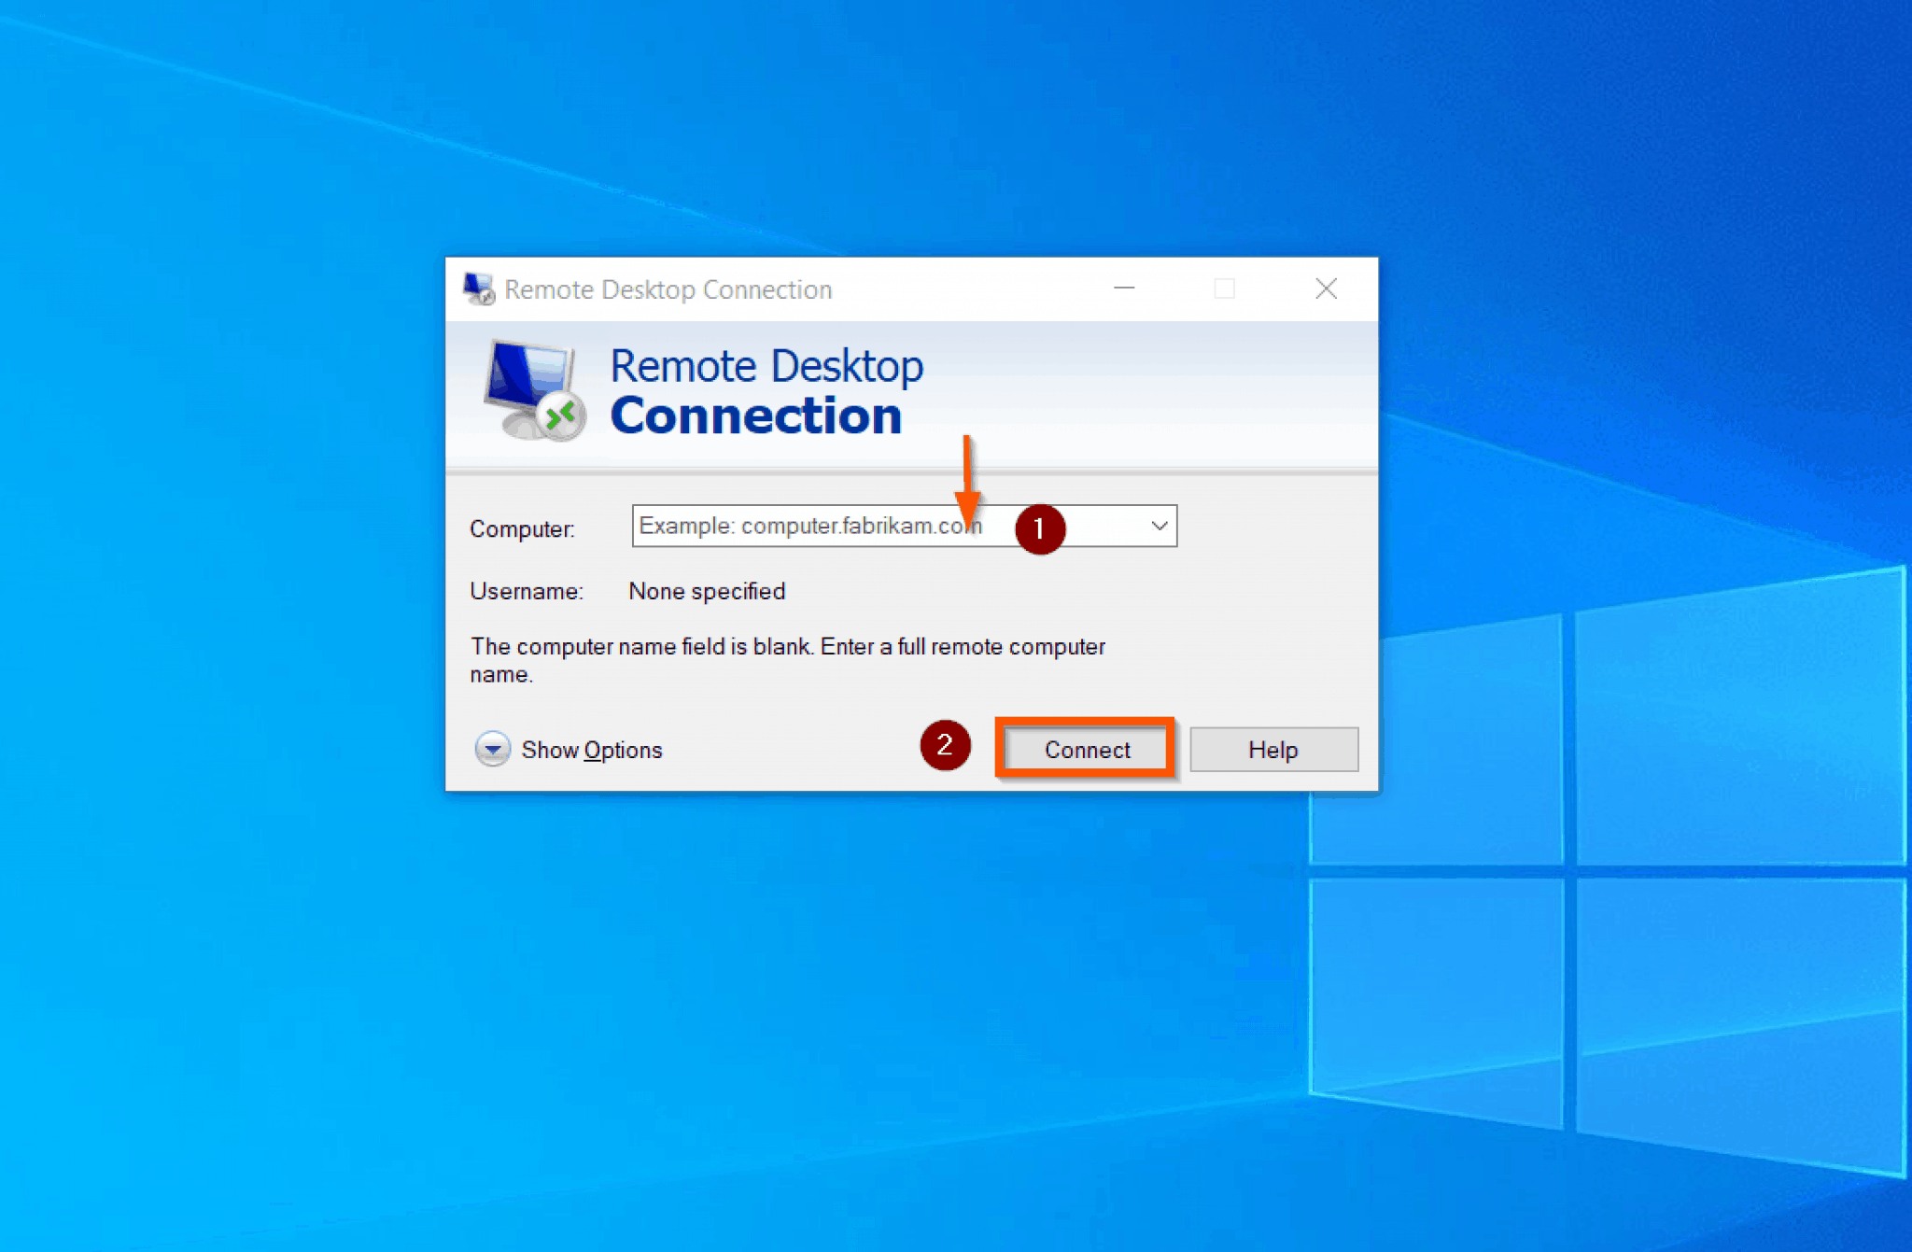
Notes:
People were able to RDP from their home internet directly to their public IP’d workstations.
I was frankly horrified. I opened up Wireshark, and my machine was flooded with garbage from all of the IPs that are blocked by even terrible home routers these days. The lab computers were all being hacked once every couple of weeks and trash was being installed regularly.
Side note: I heard this a lot from Universities that didn’t want to limit their students’ exposure to the Internet.
I had a meeting with all of the stake holders and as like, “wtf?”
People need to get into their machines. I said that is what a VPN was for. I was told that that hundreds of people would complain, I made a bet that it would be closer to a dozen. It was actually 5.
Changed the Default Accept to Default Deny and added a line for TCP Established connectivity out. The client services team did one more round of clean up in their lab, and then they did a yearly rebuild of their lab.

Slide 38
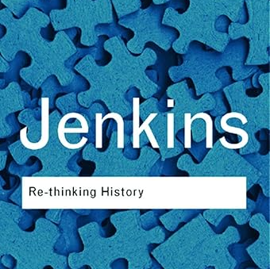
Best “Technical” Book
“Re-thinking History” by Keith Jenkins
Does not mention routing once
Postmodern Historical Theory
Notes:
URL: https://www.amazon.com/Re-thinking-History-Routledge-Classics-96/dp/0415304431/
Pg. 71 – “all those old organizing frameworks that pre-supposed the privileging of various centers are no longer regarded as legitimate and natural frameworks.”

Slide 39

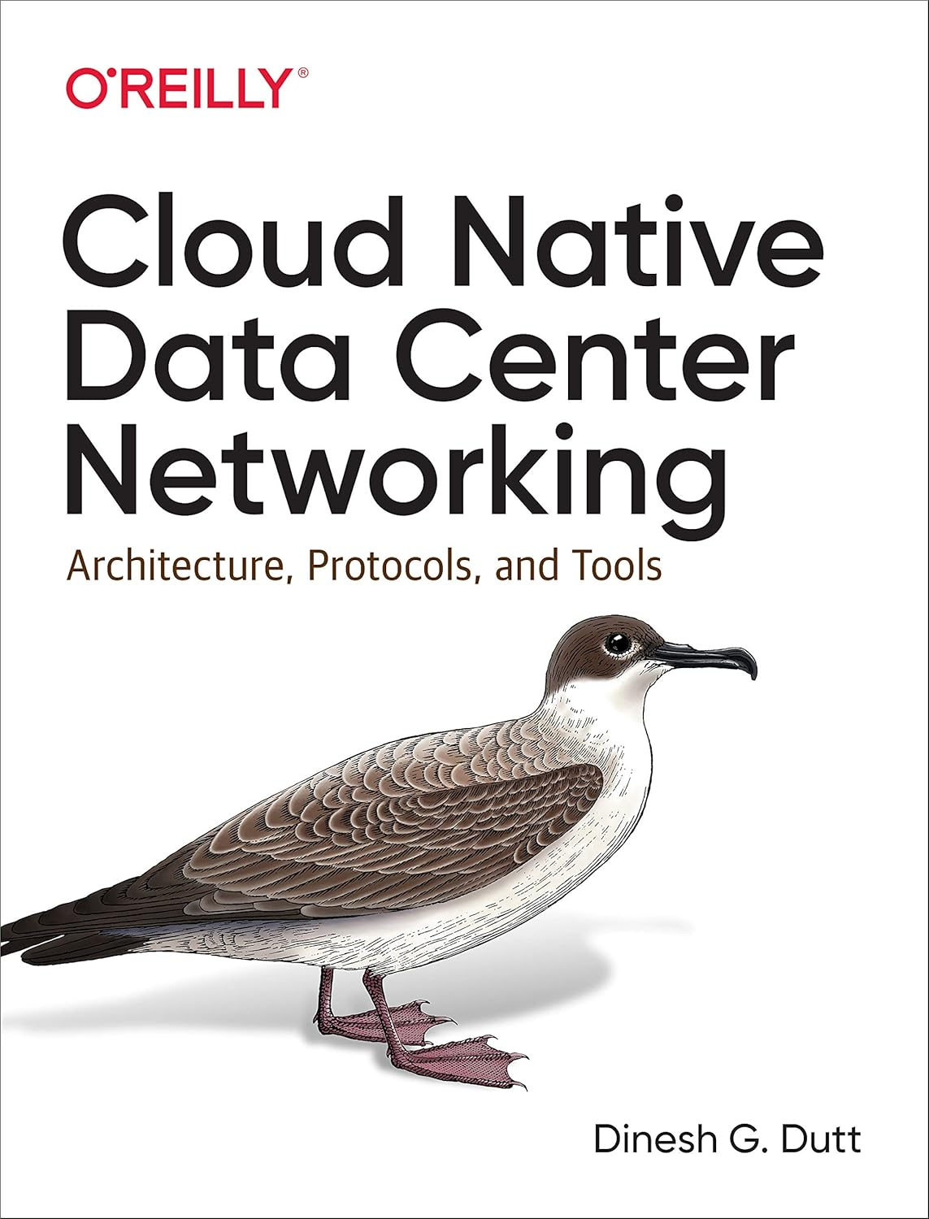
Actual Best Technical Books
Notes:
No book influenced my pre-CLOS fabric network designs designs more than the JUNOS book.
IMAGE: https://www.oreilly.com/library/cover/9780596805449/1200w630h/
URL: https://www.amazon.com/Cloud-Native-Data-Center-Networking/dp/1492045608/
I know the author of the book on the right and this work has been foundational to my data center designs in the 2020s.

